Slide 1
Data Science Unit1: Introduction
Lecture 1

Slide 2
Overview of Data Science
Data Science is the practice of mining large data sets of raw data, both structured and unstructured, to identify patterns and extract actionable insight from them.
Data science deals with vast volumes of data using modern tools and techniques to fins unseen patterns , derive meaningful information and make business decisions.
Data science is a blend of various fields like probability and Statistics , programming, Analysis, cloud computing etc.
Data science is the extraction of actionable insights from raw data.

Slide 3
Data Vs Information
Data Information
Raw facts, figures and statistics 1. Processed/organized data.
No contextual meaning 2. exact meaning and organized
Data can be characters, numbers 3. Organized and presented in context- value to data

Slide 4
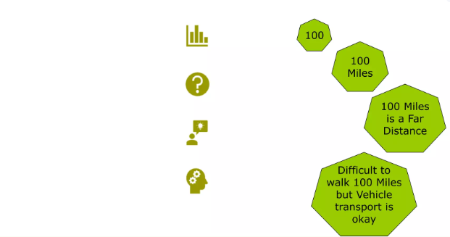
Data and Information
Figure: Data and Information

Slide 5
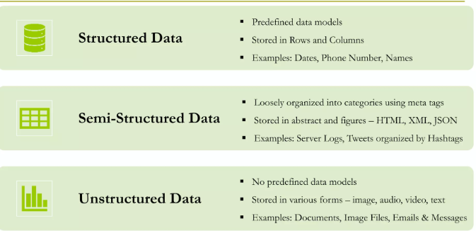
Types of Data and it’s Representation

Slide 6
Data Science Lifecycle
Capture: Data Acquisition, Data entry, signal reception, data extraction, gathering raw structured and unstructured data.
Maintain: Data warehousing, data cleansing, data processing, data architecture- taking raw data and putting it in the form that can be used.
Process: Data mining, clustering/classification, data modeling , data summarization- Data scientists take the prepared data and examine its patterns, ranges and biases to determine how useful it will be in predictive analysis.

Slide 7
Analyze: Exploratory, predictive analysis, regression, text mining
Communicate: Data reporting, data visualization, business intelligence, decision making-analysts prepare the analyses in easily readable forms such as charts, graphs and reports.

Slide 8
Data Science Applications
Healthcare:
Gaming
Image recognition
Recommendation systems
Logistics
Fraud detection.

Slide 9
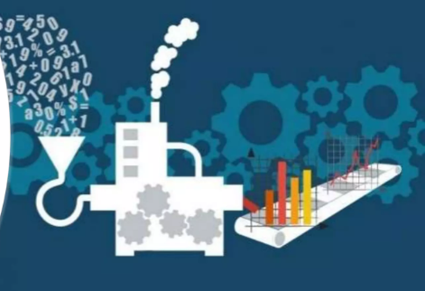
Data Value Chain
The evolution of data from collection to analysis, dissemination and the final impact of data on decision making.

Slide 10
Big Data Value Chain
Data Capture and Acquisition
Data preprocessing and cleansing
Data curation, integration, and enrichment
Data Analysis
Data Visualization

Slide 11
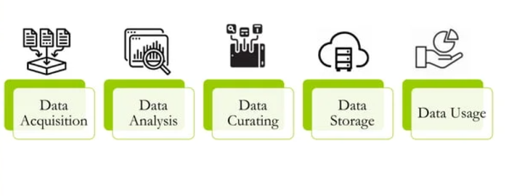
Big Data Value Chain

Slide 12
Big Data
Big Data refers to datasets that are too large, complex, and dynamic to be processed and analyzed by traditional data management tools.
Few Definitions
It refers to a massive amount of data that keeps on growing exponentially with time.
It is so voluminous that it cannot be processed or analyzed using conventional data processing techniques.
It includes data mining, data storage, data analysis, data sharing, and data visualization.
The term is an all-comprehensive one including data, data frameworks, along with the tools and techniques used to process and analyze the data.

Slide 13
Big data is characterized by the 3Vs:
Volume: The vast amount of data generated from various sources (e.g., social media, sensors, transactions).
Velocity: The speed at which data is generated and processed (e.g., real-time data streams).
Variety: The different types of data (structured, unstructured, and semi-structured).

Slide 14
History of Big Data
The History of Big Data Although the concept of big data itself is relatively new, the origins of large data sets go back to the 1960s and ‘70s.
Around 2005, people began to realize just how much data users generated through Facebook, YouTube, and other online services.
Hadoop (an open-source framework created specifically to store and analyze big data sets) was developed that same year.
NoSQL also began to gain popularity during this time.
The development of open-source frameworks, such as Hadoop (and more recently, Spark) was essential for the growth of big data because they make big data easier to work with and cheaper to store.
In the years since then, the volume of big data has skyrocketed. Users are still generating huge amounts of data—but it’s not just humans who are doing it.

Slide 15
With the advent of the Internet of Things (IoT), more objects and devices are connected to the internet, gathering data on customer usage patterns and product performance.
The emergence of machine learning has produced still more data. While big data has come far, its usefulness is only just beginning.
Cloud computing has expanded big data possibilities even further.
The cloud offers truly elastic scalability, where developers can simply spin up ad hoc clusters to test a subset of data

Slide 16
Why Big Data
The importance of big data does not revolve around how much data a company has but how a company utilizes the collected data.
Every company uses data in its own way; the more efficiently a company uses its data, the more potential it has to grow.
The company can take data from any source and analyze it to find answers which will enable:

Slide 17
Benefits of Big Data
Cost Saving
Time Reductions
Understand the market conditions
Control online reputation
Boost Customer Acquisition and Retention
To solve Advertisers problem and offer marketing insights

Slide 18
Big Data Challenges:
Storage and processing: Traditional databases are insufficient for managing big data.
Data Security and Privacy: Sensitive information in large datasets requires proper handling.
Analysis: Big data requires advanced algorithms and tools to extract meaningful patterns.

Slide 19
Skills and Tools Required for Data Science
To be proficient in data science, one needs a mix of technical, analytical, and domain-specific skills. These include:
Skills:
Programming: Knowledge of languages like Python, R, and SQL is fundamental for data manipulation and analysis.
Mathematics & Statistics: Understanding statistical methods (e.g., regression, hypothesis testing, probability) and linear algebra for machine learning.
Data Wrangling: Ability to clean and preprocess data using tools like Pandas and Excel.
Machine Learning: Knowledge of supervised and unsupervised learning algorithms, model evaluation, and tuning.

Slide 20
Tools & Technologies:
Python Libraries: Pandas, NumPy, Scikit-learn, TensorFlow, PyTorch
R: For statistical analysis and data visualization.
SQL/NoSQL Databases: To handle and query data.
Tableau/Power BI: For creating interactive dashboards and visualizing data.
Hadoop and Spark: For big data processing.

Slide 21
Ethical Considerations in Data Science
With the increasing application of data science in real-world scenarios, ethical considerations are crucial. Some of the major ethical concerns include:
Privacy and Security in Data Science:
Privacy Concerns: Data scientists often work with personal or sensitive data, which poses risks related to privacy violations. Protecting personally identifiable information (PII) is critical.
Security Measures: Ensuring that data is secure from unauthorized access or cyber-attacks by implementing encryption, secure communication channels, and robust authentication.
Example: GDPR (General Data Protection Regulation) in the EU has set strict standards for data protection and privacy.

Slide 22
2. Bias and Fairness in Data Science:
Algorithmic Bias: Machine learning models can inherit biases present in the data, leading to unfair predictions. This can affect hiring, loan approval, and criminal justice.
Fairness in Decision-Making: Ensuring that algorithms do not discriminate based on gender, race, age, or other irrelevant factors.
Example: The use of biased data in facial recognition technology has led to controversies regarding racial biases in automated systems.
3. Transparency and Accountability in Data Science:
Model Transparency: Machine learning models, especially deep learning, are often seen as "black boxes." Data scientists must ensure that models are interpretable and that their decisions can be explained.
Accountability: Data scientists and organizations must be accountable for the outcomes and implications of using data and AI, especially when these systems affect people’s lives.

Slide 23
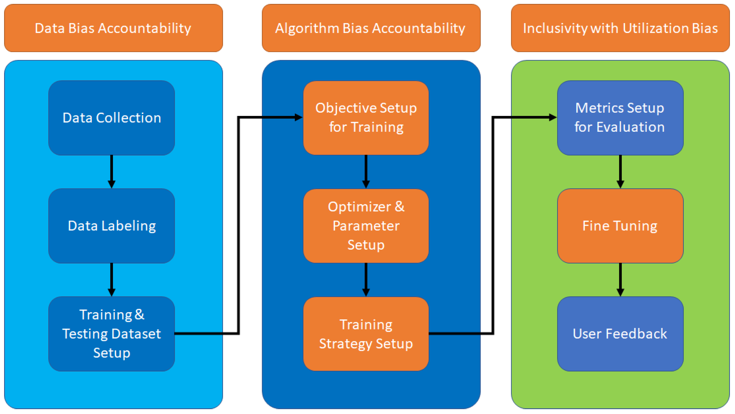

Slide 24
Applications of Data Science
Data science is used in various fields to solve real-world problems. Some prominent applications include:
1. Business Analytics:
Customer Segmentation: Analyzing purchasing patterns to segment customers and offer personalized recommendations.
Sales Forecasting: Predicting future sales based on historical data.
Churn Prediction: Identifying customers at risk of leaving a service or brand and designing retention strategies.

Slide 25
2. Social Media Analysis:
Sentiment Analysis: Analyzing social media posts to understand public opinion about a brand or topic.
Trend Detection: Identifying emerging trends by analyzing conversations and hashtags.
Influencer Marketing: Identifying key influencers for marketing campaigns.

Slide 26
3. Healthcare Analytics:
Predictive Healthcare: Using patient data to predict disease outbreaks, patient outcomes, or readmission risks.
Medical Imaging: Analyzing medical images (X-rays, MRIs) using deep learning algorithms to detect diseases such as cancer.
Personalized Treatment Plans: Tailoring treatments based on the genetic data of patients (precision medicine).

Slide 27
3. Environmental Analytics:
Climate Change Modeling: Predicting the effects of climate change using historical environmental data.
Resource Management: Optimizing energy and water usage through real-time data analysis.
Wildlife Conservation: Analyzing population trends and tracking animal movements to protect endangered species.

Slide 28
4. Local Use Cases:
Smart Cities: Using data to optimize urban infrastructure, traffic management, and public services.
Education: Analyzing student performance data to improve learning outcomes.
Agriculture: Using sensor data for precision farming, optimizing irrigation, and predicting crop yields.

Slide 29
Future of Data Science
Collaborative Data Science:
As organizations become more data-driven, data science will involve cross-disciplinary teams, combining domain experts with data scientists to ensure that insights are actionable and relevant to specific business problems.
This trend toward collaboration will also foster more inclusive, diverse approaches to solving problems with data.

Slide 30
Conclusion:
The future of data science is incredibly bright, with its applications continually expanding and transforming industries.
As technology advances, data scientists will be at the forefront of these innovations, using cutting-edge tools and techniques to solve increasingly complex challenges.
This creates vast opportunities for data science professionals, who will play a key role in shaping the future of business, technology, and society at large.

